Slide 1
UNIVERSITY INSTITUTE OF COMPUTING
Master of Computer Applications
Internship Report
2020-22
An Overview
of Computing
&
Career Planning
Student Name: POOJA THUKRAL
UID: 20MCA1322
Section/Group: 20MCA2/A
Supervisor Name: AMANDEEP KAUR
Employee Code:
Designation: ASSISTANT PROFESOR(UIC)
Internship Report Presentation
DISCOVER . LEARN . EMPOWER

Slide 2
Presentation Outline
Company's introduction
Company's leading product on which am working
Three major domains of product
Processes configured and tasks involved
Methodologies/tools involved
JIRA software
API Testing with Postman
Components of postman
Working with OKTA
Conclusion
References used

Slide 3

COMPANY'S INTRODUCTION
Start Up Farms International LLC (SUFI) provides early-stage venture capital, physical and back-office infrastructure, professional guidance and mentoring to Start-up companies developing software solutions and web services. Start-ups that meet the company’s base criteria have a founding team that has:
Taken their product from concept to working prototype
Technical depth
Patentable intellectual property that differentiates the product
Understanding / experience in the target market
Total commitment and evident passion for their product

Slide 4

The company’s facility provides full-service office space for the companies in which we invest and our staff provides back-office shared services that enable each team of entrepreneurs to focus on products and markets without unnecessary distractions.
The company places a high priority on:
New, market-altering solutions to well-articulated problems.
New or niche markets with demonstrable growth trajectories, especially markets that may be shaped by the entrepreneurs' products

Slide 5

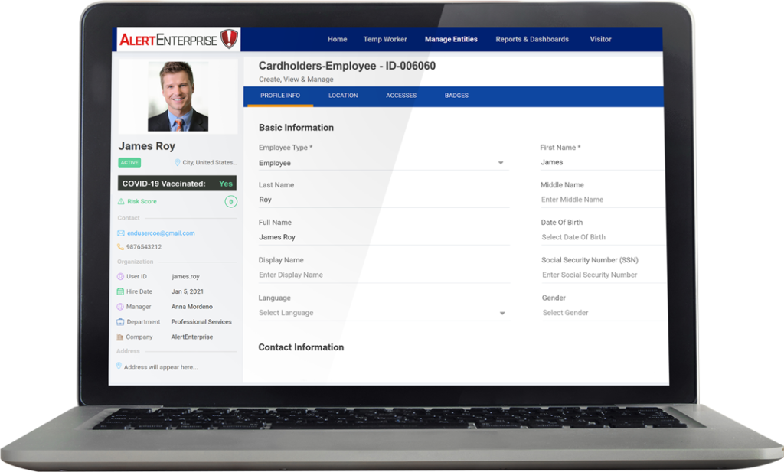
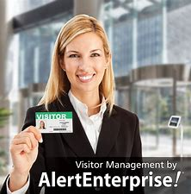

When anyone desires for a unified cyber-physical security convergence platform by linking IT, OT and Physical Security for risk prevention, detection and mitigation then one of the most super reliable platform which comes into mind is AlertEnterprise (Physical | Logical Security convergence).
It's been founded by Virsa systems Compliance solution now the foundation for SAP GRC.
Vision came from fortune 100 and other customers. Top tier VC funded company in silicon valley. It’s vision is to make the world a safer place.
Its unique advantages include intelligence—a predictive analysis, active policy enforcement, convergence, cyber care, total cost of ownership. There is harmonization of data across each platform.

Slide 6
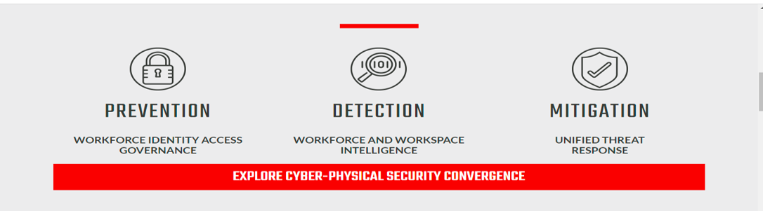
Alert Enterprise basic principle
By providing great detection mechanisms so that threats can be found and then futher measures being taken accordingly.
We have suggestive as well as preventive rule setting system in our UI for preventive risks.
Mitigation means how we tackle with threats and vanish them keeping in mind its prevention in future.

Slide 7
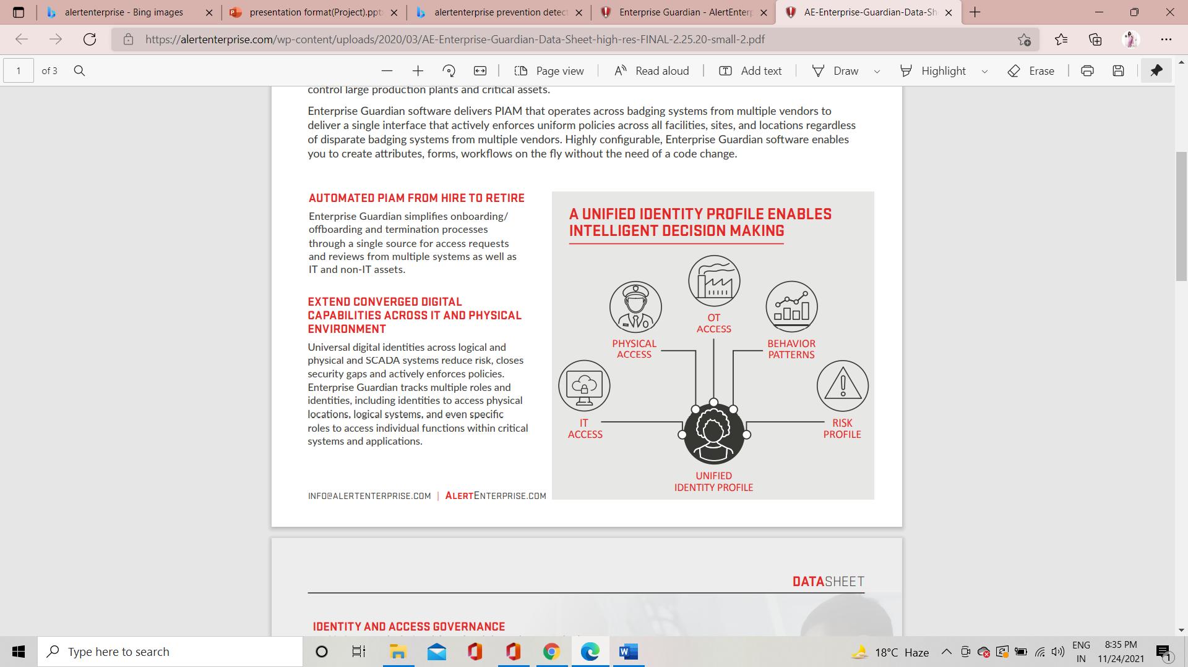
Company's leading product on which am working
ENTERPRISE GUARDIAN
Enterprise Guardian is the industry-leading Physical Identity and Access Management (PIAM) solution that integrates Physical Access Control Systems (PACS) and badging with enterprise applications, HR systems and IT directory services like Active Directory and LDAP.
AUTOMATED PIAM FROM HIRE TO RETIRE
Enterprise Guardian simplifies onboarding/ offboarding and termination processes through a single source for access requests and reviews from multiple systems as well as IT and non-IT assets

Slide 8
EXTEND CONVERGED DIGITAL CAPABILITIES ACROSS IT AND PHYSICAL ENVIRONMENT
Universal digital identities across logical and physical and SCADA systems reduce risk, closes security gaps and actively enforces policies. Enterprise Guardian tracks multiple roles and identities, including identities to access physical locations, logical systems, and even specific roles to access individual functions within critical systems and applications.
INTEGRATED VISITOR IDENTITY MANAGEMENT IDENTITY INTELLIGENCE
Seamless integration with Visitor Identity Management enables you to centralize all aspects of the visitor identity lifecycle through a single interface. When integrated with AI-powered Identity Intelligence technology, Enterprise Guardian software provides you the ability to conduct risk analysis prior to provisioning access, helping you protect against insider threats
SELF-SERVICE PORTAL FOR INDEPENDENCE AND AUTONOMY
Empower users, managers, and area owners in your organization and reduce the burden of your support staff through the Self-Service Portal. The Self-Service Portal helps you promote independence and autonomy across your identity population. Employees can manage badge and access events such as reporting a lost or stolen badge, resetting a password or PIN, and requesting physical access to an area or location. Area owners or building administrators can manage their buildings and people who have access and perform automated and manual access review re-certifications. System administrators can disable badges or remove access in emergencies

Slide 9
THREE MAJOR DOMAINS
IDENTITY AND ACCESS GOVERNANCE
Upfront analysis for risk and training prior to assigning critical access
• Access certification and role lifecycle management
• Compliance automation and active enforcement with configurable rules engine
• Expiring training
• Background checks
• Conflicting access
• Number of active badges
• Provisioning to on-premise, cloud applications and badging systems
• Centralized contractor management for non-HR cardholders
PHYSICAL IDENTITY MANAGEMENT
Common digital identity for logical and physical Identities with active directory integration
• Single interface to provision across multiple badging systems
• Support for high security standards like PIV-I, PIV-C, FICAM, etc.
• Centralized contractor management to manage non-HR temporary badge holder
MANAGE ACCESS TO OPERATING ASSETS/ SCADA ASSET
• Monitor and restrict access to key roles for critical plant operating assets
• Integrate events and alerts from SCADA, DCS and plant applications into security and operational dashboards

Slide 10
Eliminate gaps between logical and physical identities
• Scale the operation of Access Control Systems to meet enterprise needs across time zones and geographies
• Deliver unified operation and enforce policies uniformly across Access Control Systems from multiple vendors without changing underlying systems
• Automate physical security controls and audit reporting required by various industry regulations
• Reduce cost and reduce risk by eliminating overlap of function, extending the useful life of existing systems and enhancing overall security • Provide a running migration path from existing Access Control systems to newly selected systems when desired, without the risk of disruption or outage
Enterprise guardian user interface

Slide 11
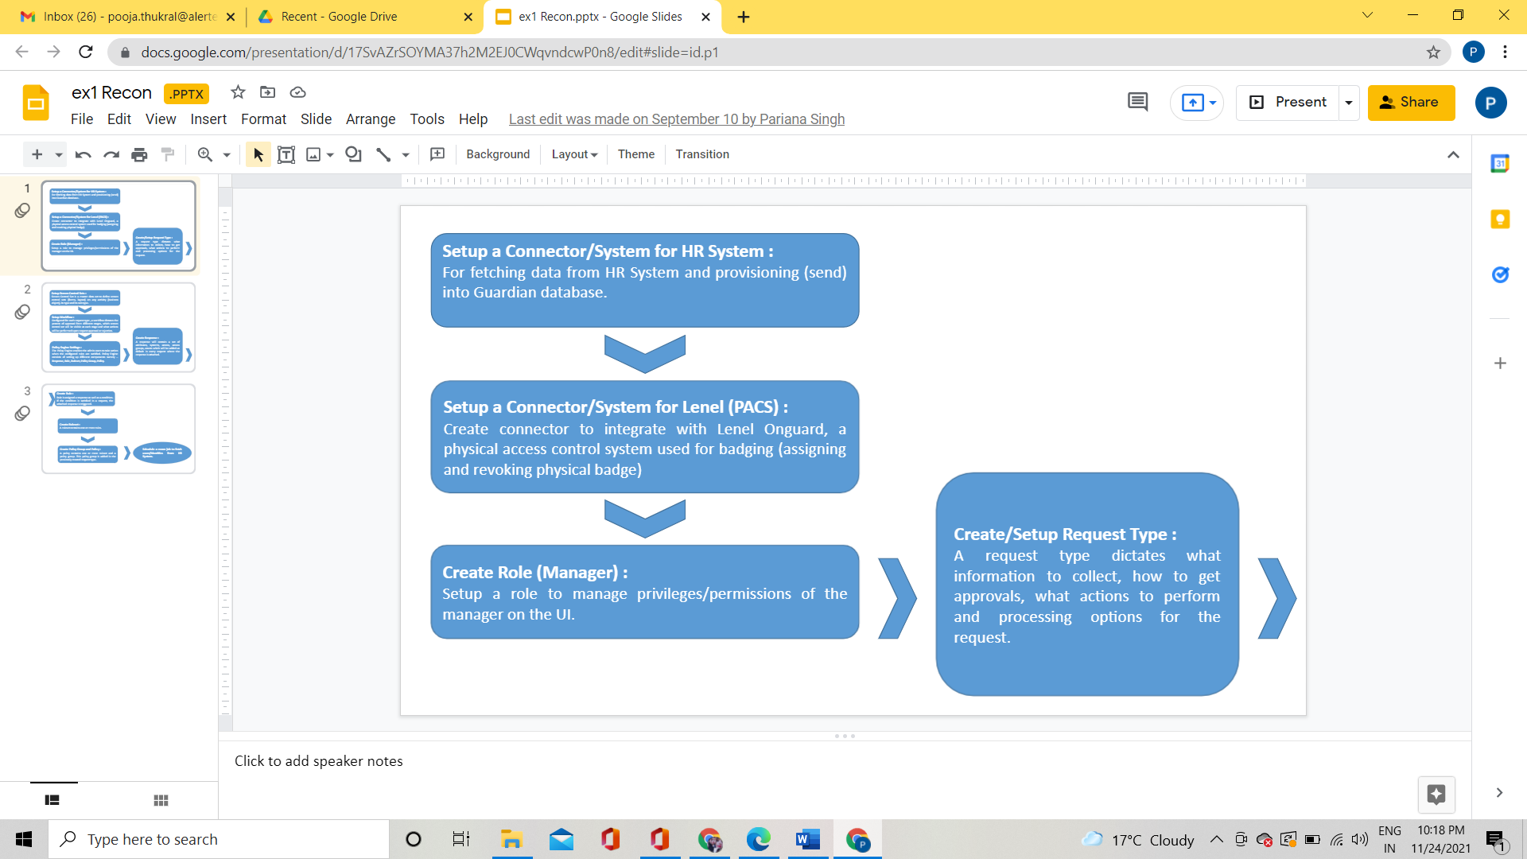
Let's have an insight to the processes configured and the tasks involved.
RECONCIALATION: Recon is the very first job done. When a new user joins the organization then many tasks need to be performed for that we are required to fetch data from some source like views, databases, active directories and many more.

Slide 12
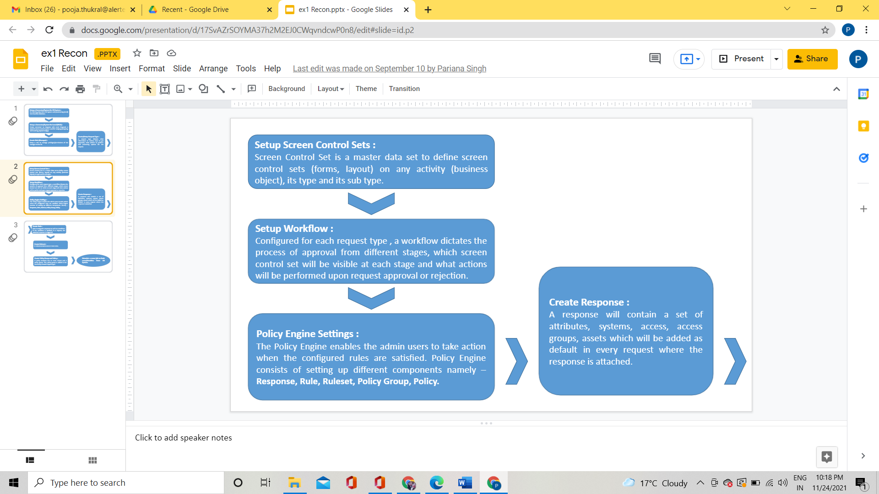

Slide 13
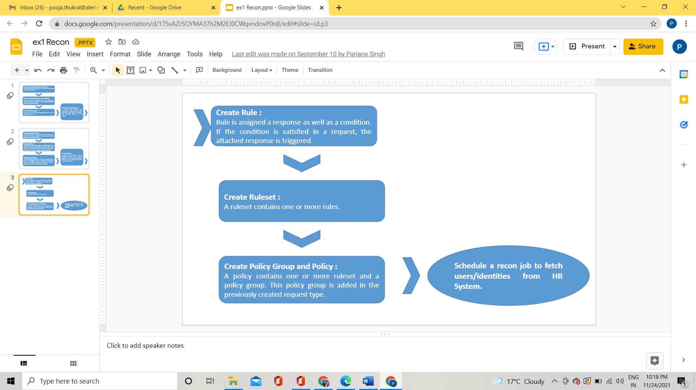

Slide 14
Methodologies/tools used
JIRA SOFTWARE
API TESTING WITH POSTMAN
WORKING WITH OKTA

Slide 15
JIRA SOFTWARE
Jira is a series of fast-paced task management solutions that enable collaboration on all teams from concept to customer, enabling you to do the best work of your life, together. Jira offers a number of products and application options designed for the purpose of Software, IT, Business, Ops teams, and more.
Keep reading to see what is best for you. Jira assists teams to organize, deliver, track, report, and manage work and brings teams together in everything from aging software development and customer support to startups and businesses.
Software teams build better with Jira Software, the # 1 tool for older groups. Bring an amazing service experience to all teams from IT, Dev, Ops, and more with Jira Service Management.
Business teams can unlock faster power and better engage with Jira Work Management. Jira Align is a fast-paced business planning platform that integrates work with quality.
With templates and solutions designed for each team and Jira as your common language - the work goes smoothly and clearly across your organization.
Good product traffic software will also have tools to help you measure the costs and benefits of programs and determine where your team should work first.

Slide 16
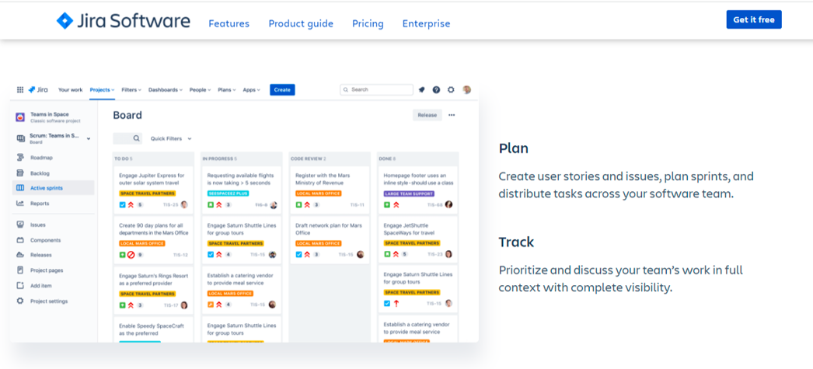
You can keep a track over to the workflow. Like if an issue occurs while testing then we log that issue over JIRA. For that issue a workflow is maintained like the issue was OPEN>Assigned to DEVEOPS TEAM>Released to QA team>Close the issue. Every team has a unique process for shipping software. Use an out-of-the-box workflow, or create one to match the way your team works.
You can add a bug description, attachments, identify the affected versions, assign them to the right members to fix, and assign severity levels, all while having a single overview of everything in the backlog.

Slide 17
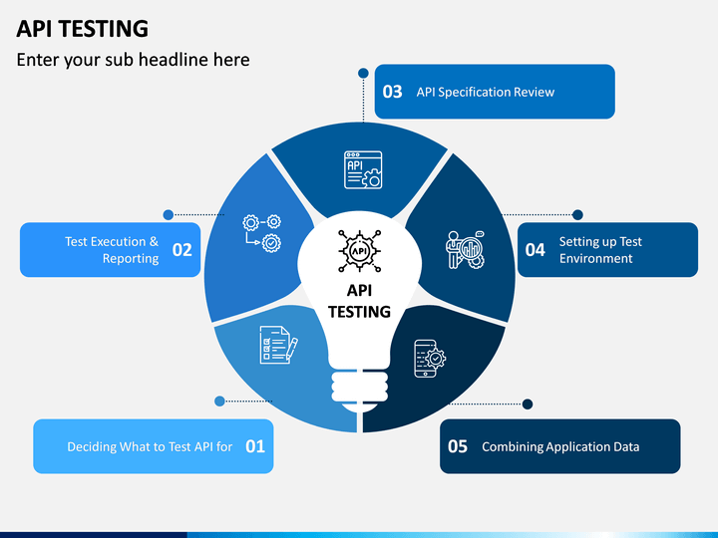
API TESTING WITH POSTMAN
Postman is the collaboration platform for API development.
Postman simplifies each step of building an API and streamlines collaboration so you can create better APIs—faster.
Postman has just started as a separate project to solve a particular problem: Abhinav Asthana, Chief Postman's co-founder and co-founder, is determined to create a tool that will simplify the API testing process.
As the use of the tool exploded rapidly, Abhinav enlisted two of his colleagues, Ankit Sobti and Abhijit Kane, to help him form Postman, Inc.
Postman is now the world's leading collaborative platform for API development, and three founders are still leading the company in corporate development.

Slide 18
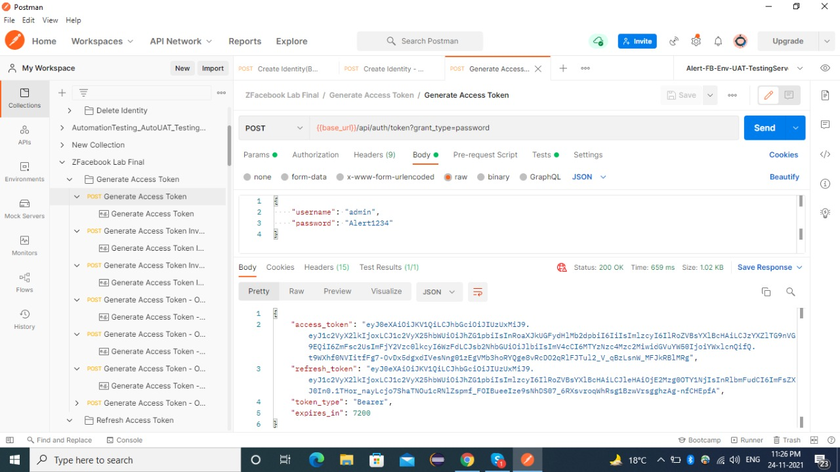
POSTMAN UI

Slide 19
Components of Postman
Collections: Postman Collection means a group of API requests that are already stored in Postman and can be organized into folders. Any number of folders can be created within the collection. Applying the same applications to folders and groups helps the client to better plan and document their applications. Import and export of simple API
Postman variables: Postman variables work in the same way as system variables. These are signs that can take various values. You can save values on variables and apply them throughout applications, locations, collections, and scripts.
Environment in Postman: A collection of key-value pairs is called an environment. Each name of the variable represents its keys. And referencing the name of the variable allows you to access its value. It is a set of variables that differentiate among the requests.
Scripts in Postman: Postman is not only used for manual testing, but we can also do automatic API testing. Applications and postman collections can be used for flexible behavior. In Postman Scripts there are lines of code that allow you to perform API tests automatically. It allows you to write previous applications and test documents.
Test scripts in postman: Examination of texts after the server has received a response. In the postman, we can write test scripts to test API requests in Javascript. The test document is used to test whether your API is working properly or not, to determine if integration between services is working properly, and to check that the new upgrades did not affect any functionality of existing applications. Test scripts are also called Post-Request script.

Slide 20
WORKING WITH OKTA
Okta is cloud-based software that helps manage and protect user authentication in modern applications and developers to build patents into applications, web services, and devices. Okta helps to integrate all your applications, logins, and tools into a compact digital fabric. Okta easily connect to everything you need. Use and access to those apps is efficient and straightforward.
OKTA SSO
SSO means login once. Access to most systems without being required to sign in to each application. Okta is a cloud-based SSO platform that allows users to enter a single name and password to access multiple applications. Okta is also supported by the gates of a foreign SSO legacy company. Because each forum has its own password rules, it can be challenging to remember different passwords or password variations. This is one of the reasons why users often make the mistake of using the same password on different accounts, making all of these accounts more vulnerable. SSO is the same as the password manager .SSO no longer needs passwords.
Okta Access Gateway
Access Gateway includes legacy applications. Access Gateway allows you to easily integrate your web-based applications with Okta's Cloud SSO capabilities.

Slide 21
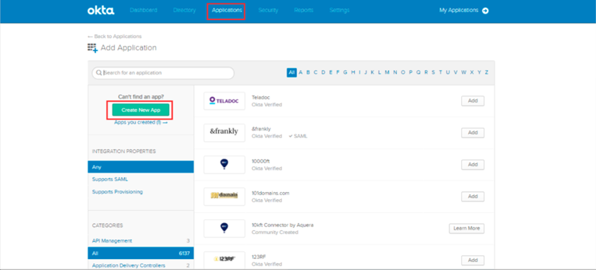
We can integrate any type of app in OKTA .These applications may be theme-based applications, SAML applications, custom Web applications; Apps based on Kerberos, or others.

Slide 22
CONCLUSION
Currently working as a Trainee at Alert Enterprise (SUFI) .
In these 2 months :
Gained expertise in understanding of the Alert products.
Working on specific module Guardian-Badging, gaining experience in programming flow of the module as well as workflows.
Worked directly with live customers with their issues regarding their application
Solved around 30+ test cases through configurations.
Reported Bugs in the application along with 1 enhancement.
Worked on application deployment Apache Tomcat web services
Configured about 10 use cases in application, executed more than 20
Also got knowledge about Lenel, Ccure, Putty.
The product’s user interface would be enhanced using latest UI technologies like html5, bootstrap etc.
Customers: The product would be used by various companies including utility companies. Some of them are:
Edison international
Facebook
Infosys

Slide 23
REFERENCES USED
1. Alert Enterprise System Requirements Specifications Version 4.0
2. Alert Enterprise Configuration Guide Version 4.0
3. Alert Enterprise User Guides Version 4.0
4. Alert Enterprise Connector Guides -Version 4.0
5. AlertEnterprise Design Documents
6. Alert Enterprise Devtracks
7. http://www.alertenterprise.com/

Slide 24
THANK YOU

